Slide 1
HCP Portal Ozempic®

Slide 2
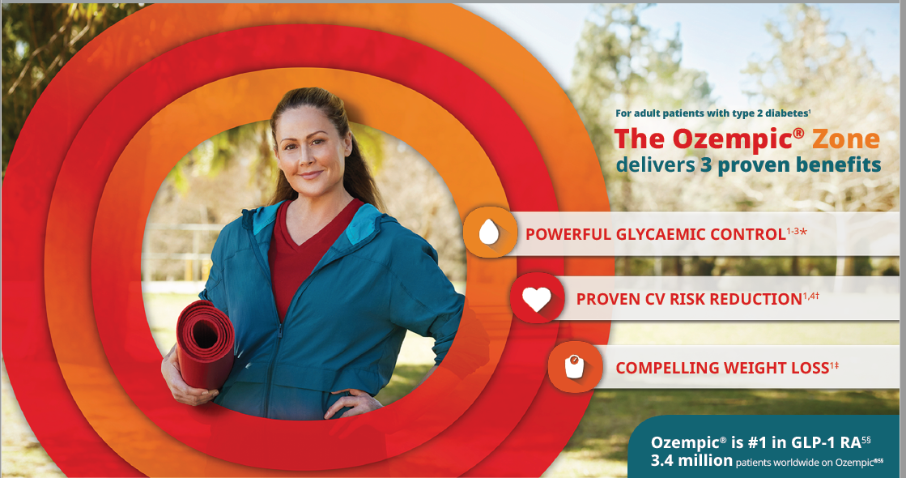
Ozempic® Homepage
E-detailer Pg 1 UE22OZM00014
Please change patient image to Veeva Vault - Ozempic_Middle Eastern female_CATHERINE_Hiking with Rings_Head wrap_RGB_HR

Slide 3
Page Structure
About Ozempic®
Ozempic® Overview
Mode of Action
Efficacy & Safety
Ozempic® & A1C
Ozempic® & Weight
Cardiovascular Benefit
Dosing & Administration
Dosing
Ozempic® Pens
Resources and Tools
Prescribing Information
Please note, prescribing information tab needs to appear at all times

Slide 4
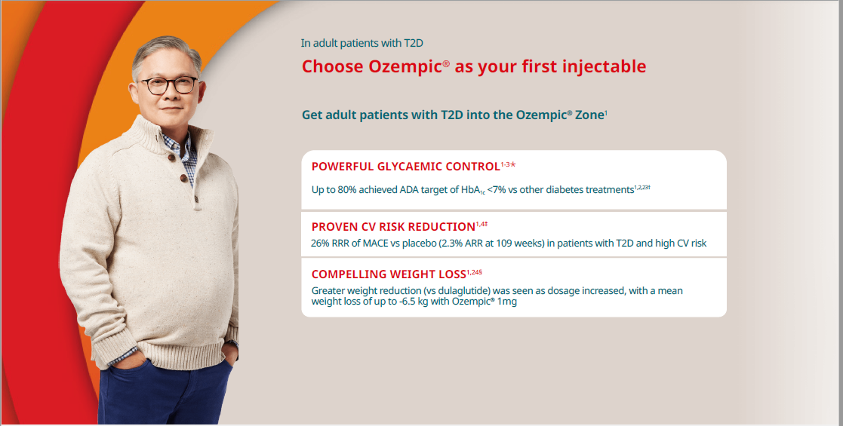
Ozempic® Overview
Change text to Help more patients with T2D and ASCVD get the power of 3
Pg 21 on E-detailer- UE22OZM00014
Change patient image to Veeva Vault - Ozempic_Core IVA_RGB_HR

Slide 5
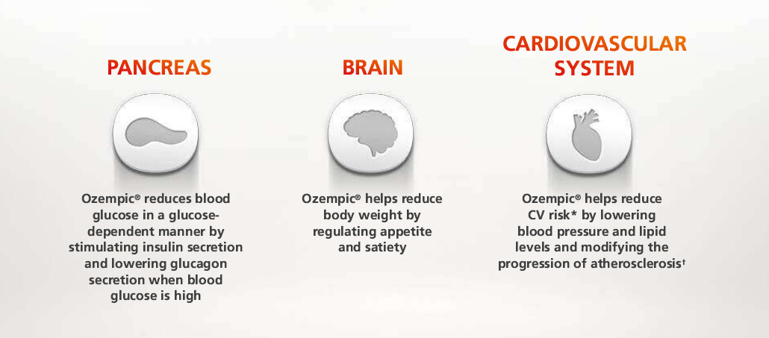
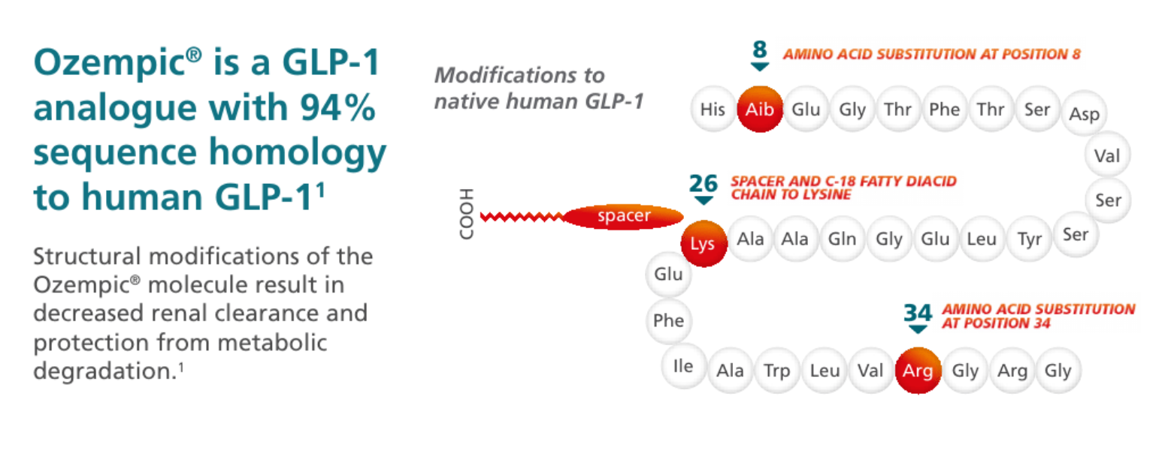
Mode of Action (Pg 1)
Glucagon-like peptide-1 (GLP-1) is a physiological hormone that has multiple actions in glucose and appetite regulation and in the cardiovascular system¹ (Reference- SPC March 2021)
How Ozempic® works in the body
(From Edetailer UE21OZM00065- Pg 42)
Ozempic® is a GLP‑1 analog with 94% sequence homology to human GLP‑1
Structural modifications of the Ozempic® molecule result in decreased renal clearance and protection from metabolic degradation
Image from COMPONENT-001457 (Veeva)
Reference- SPC March 2021

Slide 6

Mode of Action (Pg 2)
Ozempic® delivers weeklong coverage¹
~7 days | Elimination half-life of ~7 days.
Steady state exposure was achieved following 4–5 weeks of once weekly administration.
Reference SPC March 2021
Put a calendar icon showing 1 week
How Ozempic® works?
Please insert video UE21OZM00062

Slide 7
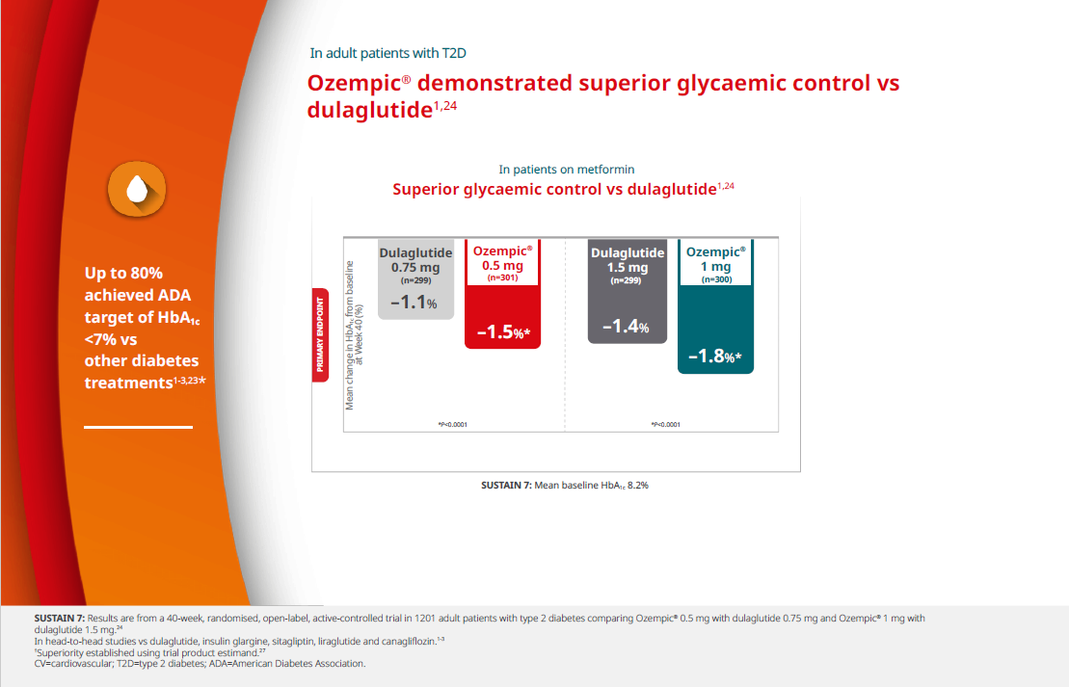
Ozempic® & A1C Ozempic® (semaglutide) injection—Powerful glycemic control for a range of T2D patient needs^{1,2,3}
Please put 2 tabs
Ozempic® VS Dulaglutide Ozempic® VS Insulin Glargine
Ozempic® VS Dulaglutide
Pg 16 from E-Detailer UE22OZM00014

Slide 8
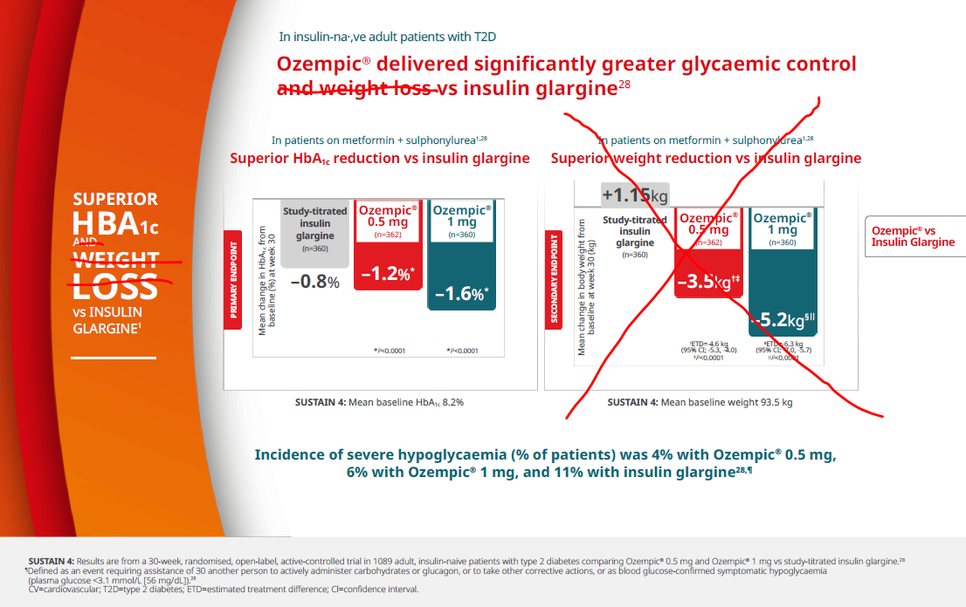
Contd..
Ozempic® VS Insulin Glargine
Pg 22 from E-Detailer UE22OZM00014
Please remove the weight graph and the sentences which are crossed
References:
1. Ozempic SPC March 2021
2. Pratley RE, Aroda VR, Lingvay I, et al, on behalf of the SUSTAIN 7 investigators. Semaglutide versus dulaglutide once weekly in patients with type 2 diabetes (SUSTAIN 7): a randomised, open-label, phase 3b trial. Lancet Diabetes Endocrinol. 2018;6(4):275-286.
3. Aroda VR, Bain SC, Cariou B, et al. Efficacy and safety of once-weekly semaglutide versus once-daily insulin glargine as add-on to metformin (with or without sulfonylureas) in insulin-naïve patients with type 2 diabetes (SUSTAIN 4): a randomized, open-label, parallel-group, multicenter, multinational, phase 3a trial. Lancet Diabetes Endocrinol. 2017:5(5):355-366.

Slide 9
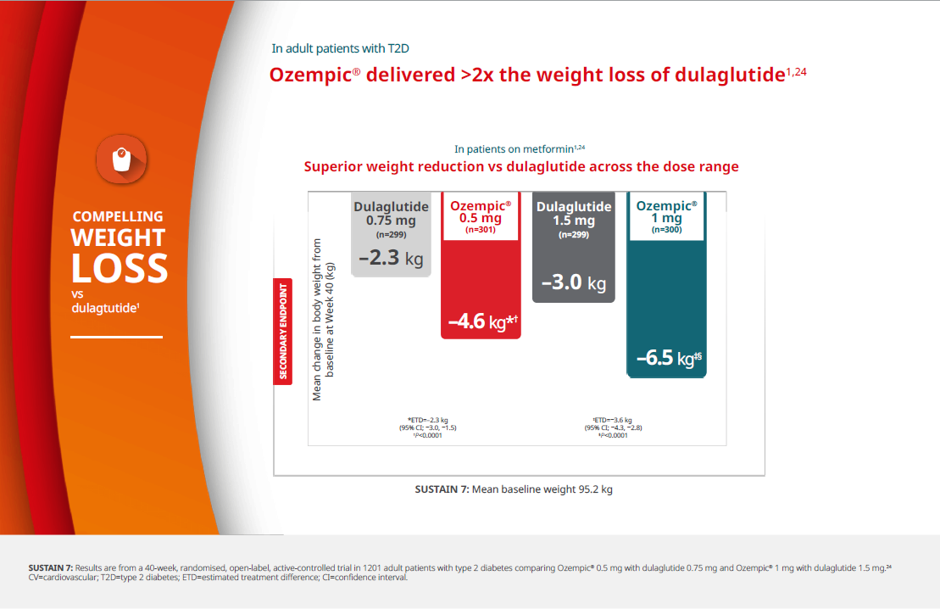
Ozempic® & Weight Ozempic® (semaglutide) injection—Compelling weight loss across doses^{1,2,3} Ozempic® is not indicated for weight loss.
Please put 2 tabs
Ozempic® VS Dulaglutide
Ozempic® VS Dulaglutide
Ozempic® VS Insulin Glargine
Pg 17 from E-Detailer UE22OZM00014

Slide 10
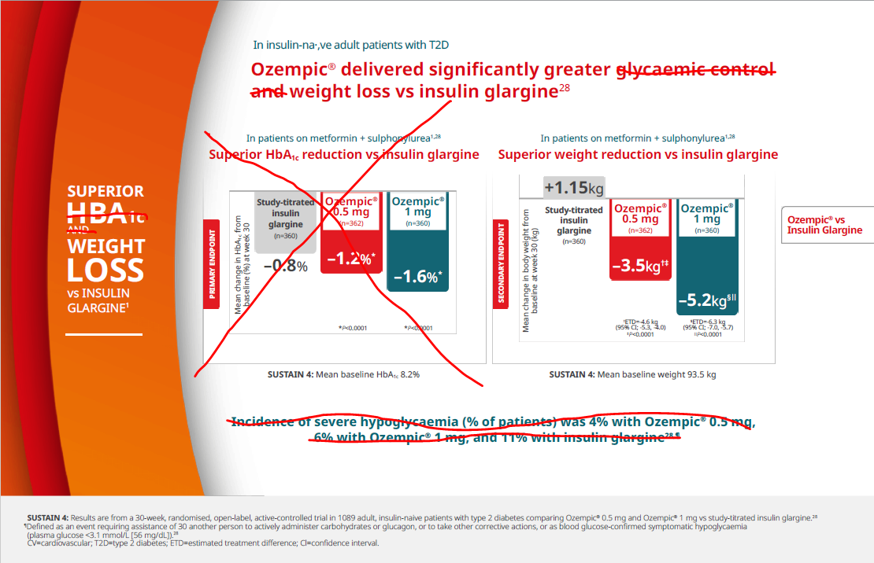
Contd..
Ozempic® VS Insulin Glargine
Pg 22 from E-Detailer UE22OZM00014
Please remove the Glycemic control graph and the sentences which are crossed
References:
1. Ozempic SPC March 2021
2. Pratley RE, Aroda VR, Lingvay I, et al, on behalf of the SUSTAIN 7 investigators. Semaglutide versus dulaglutide once weekly in patients with type 2 diabetes (SUSTAIN 7): a randomised, open-label, phase 3b trial. Lancet Diabetes Endocrinol. 2018;6(4):275-286.
3. Aroda VR, Bain SC, Cariou B, et al. Efficacy and safety of once-weekly semaglutide versus once-daily insulin glargine as add-on to metformin (with or without sulfonylureas) in insulin-naïve patients with type 2 diabetes (SUSTAIN 4): a randomized, open-label, parallel-group, multicenter, multinational, phase 3a trial. Lancet Diabetes Endocrinol. 2017:5(5):355-366.

Slide 11
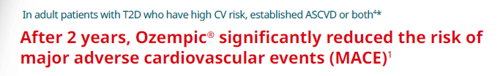
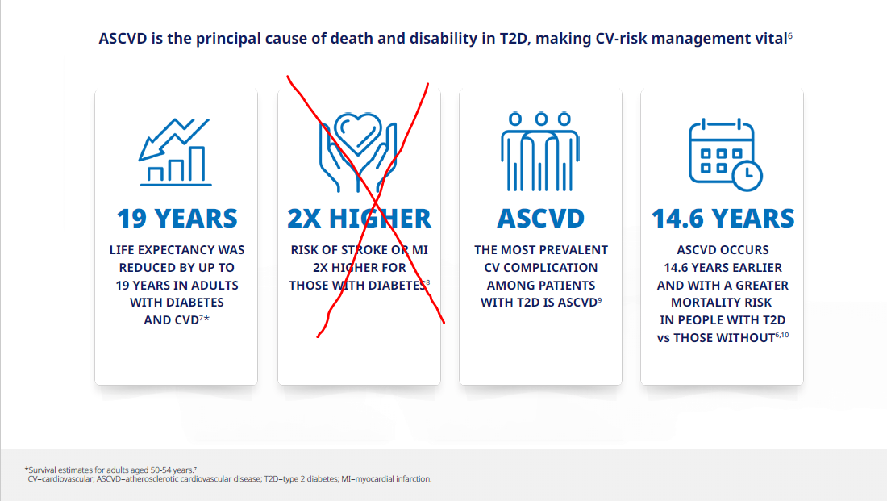
Cardiovascular Benefit
Please put this as the header
Taken from Pg 5 from E-Detailer UE22OZM00014
Taken from Pg 2 from E-Detailer UE22OZM00014
Please remove the Infographic which is crossed

Slide 12
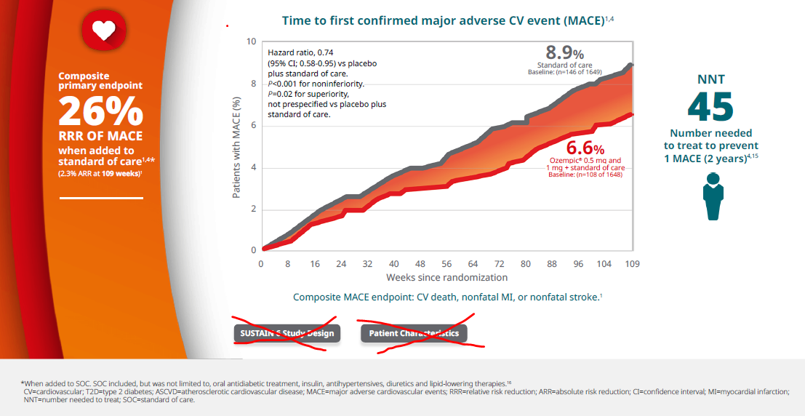
Contd…
In the Ozempic® CVOT primary endpoint, when added to standard of care^{1,4*}
Ozempic® had a 26% RRR of MACE (2.3% ARR at 109 weeks)¹
Taken from Pg 5 from E-Detailer UE22OZM00014
Please remove the rings on the left side and put the text in a red heart
Put a note
See study design below

Slide 13
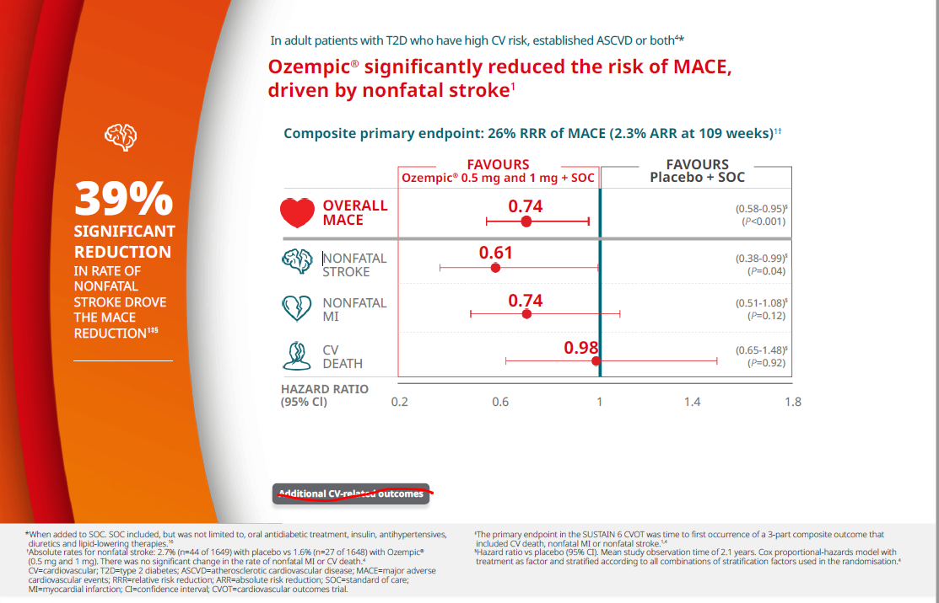
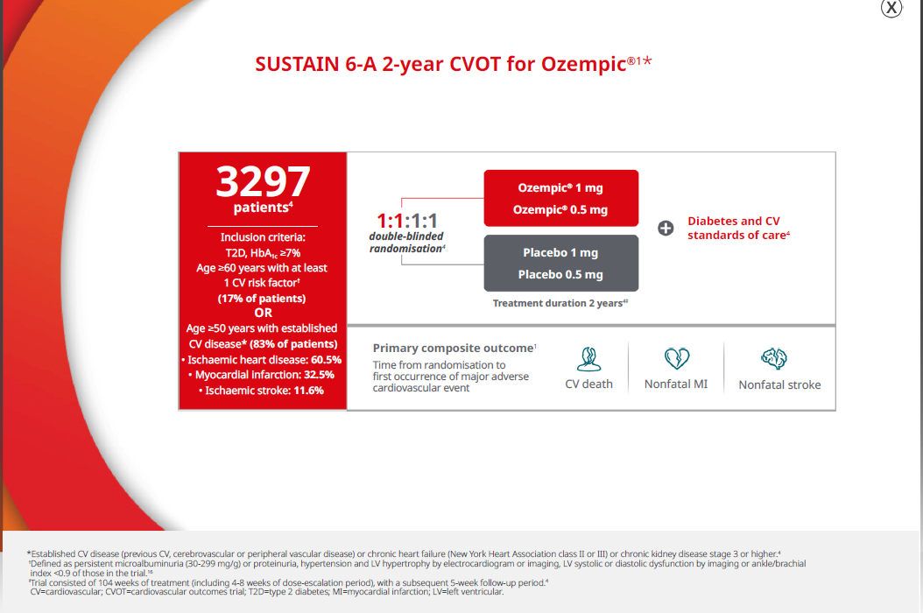
Contd…
Taken from Pg 9 from E-Detailer UE22OZM00014.
Please remove the striked out tab
Following the above,
Study Design
A 104-week, multicenter, multinational, placebo-controlled, double-blind CVOT in 3297 adult patients with inadequately controlled type 2 diabetes and ASCVD. Patients had a mean duration of diabetes of 13.9 years, a mean baseline A1C of 8.7%, and 58% were taking insulin.
Taken from Pg 7 from E-Detailer UE22OZM00014.
Please remove the striked out tab

Slide 14
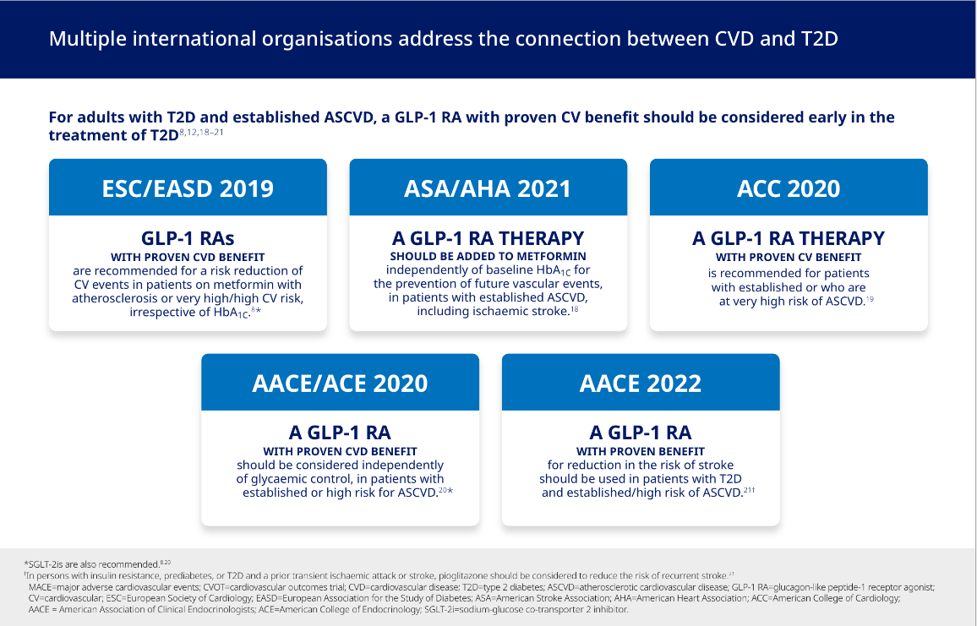
Contd…
Taken from Pg 8 from E-Detailer HQ22OZM00045

Slide 15
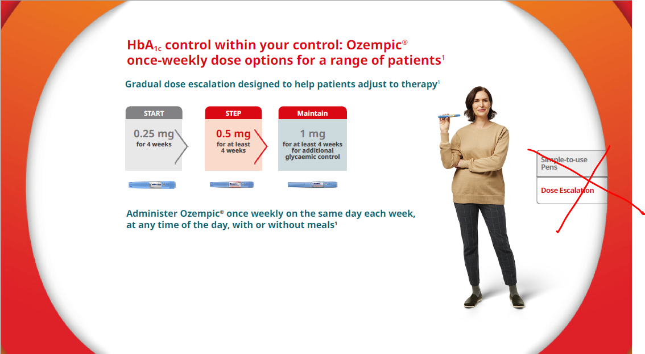
Dosing & Administration
Dose Escalation
Taken from Pg 20 from E-Detailer UE22OZM00014
Please remove the tab which is crossed

Slide 16
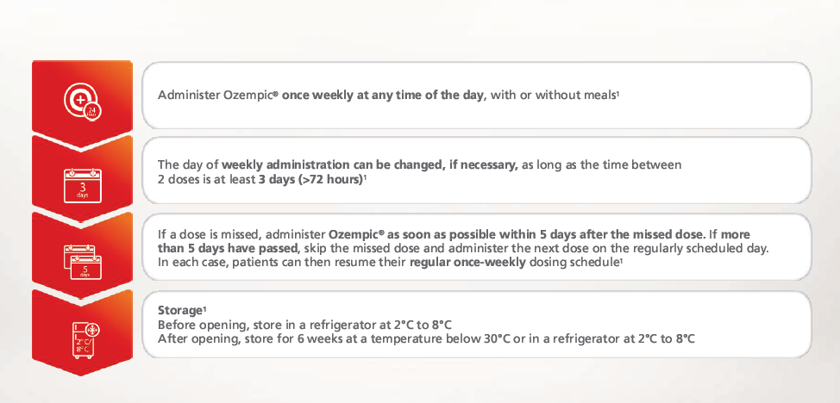
Dosing & Administration
Dosing
Taken from Pg 20 from E-Detailer UE22OZM00014
Please remove the tab which is crossed
4 simple tips for using Ozempic®
From Edetailer UE21OZM00065- Pg 38

Slide 17
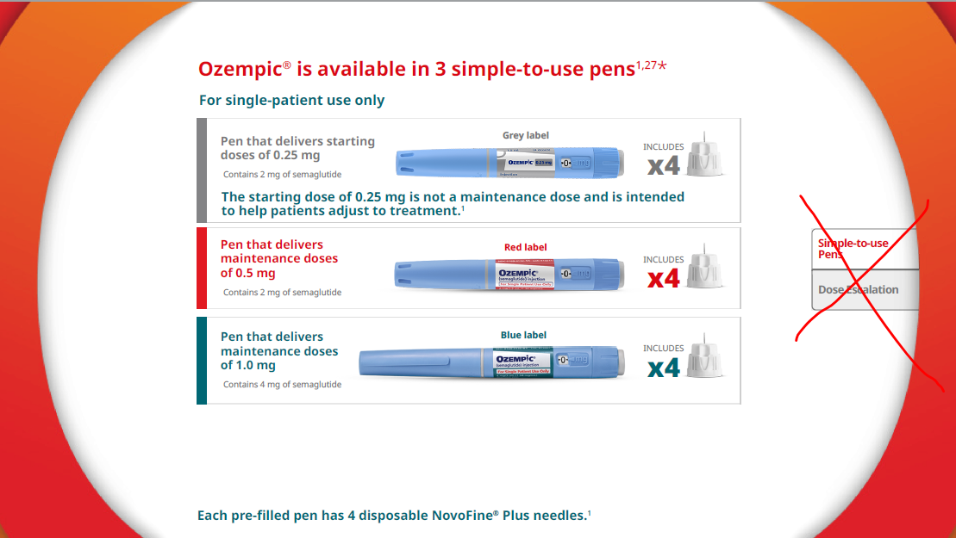
Ozempic® Pens
Taken from Pg 19 from E-Detailer UE22OZM00014
Please remove the tab which is crossed

Slide 18
Resources and Tools
Here is how to start your patient on Ozempic®
Dosing and Titration How to Use Ozempic® Pen
UE21OZM00064 UE21OZM00063

